Slide 1
MODFLOW 6—Unstructured Grids
Introduction to Groundwater Modeling using MODFLOW
September 11-15, 2023 University of Memphis, Memphis, TN

Slide 2
Unstructured Grids
Definitions
1. Cell can be connected to any number of surrounding cells
2. Not a regular MODFLOW grid
Why use them?
Grid can conform to irregular model domain boundaries
Resolution can be added in areas of interest
Why not use them?
More complicated to work with
Poor grid design can lead to errors in the flow solution that are difficult to find and quantify

Slide 3
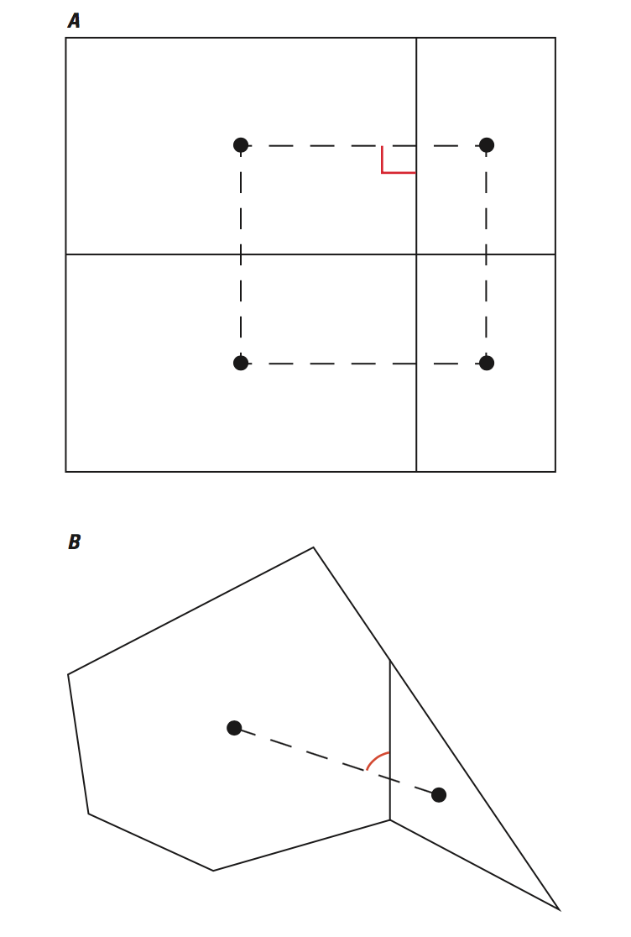
CVFD Requirements
Good
Connecting line bisects shared cell face at right angle
Possible issues

Slide 4
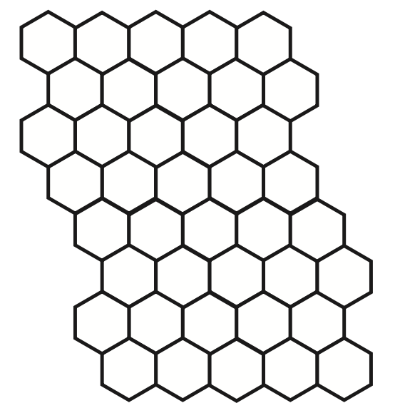
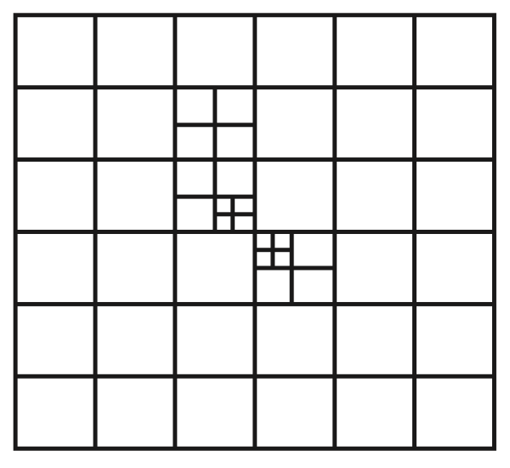
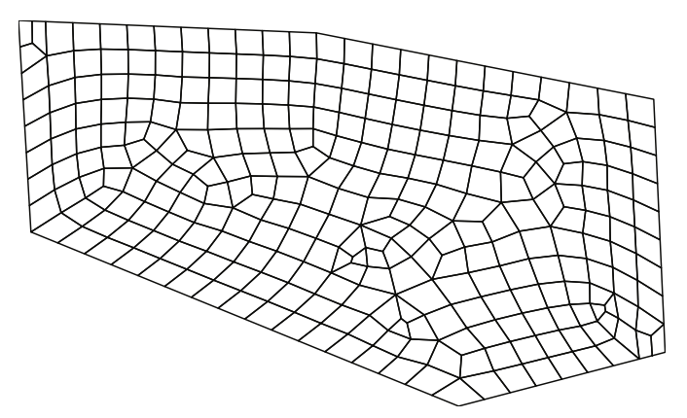
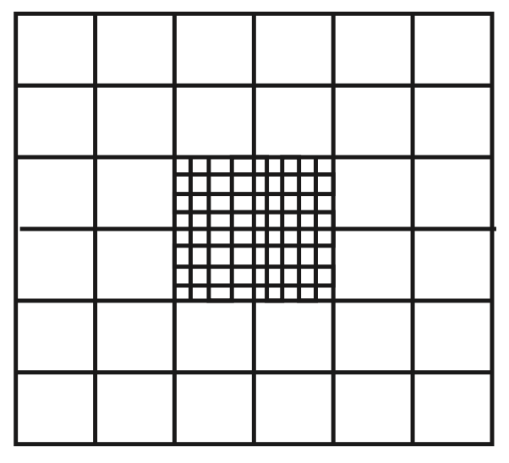
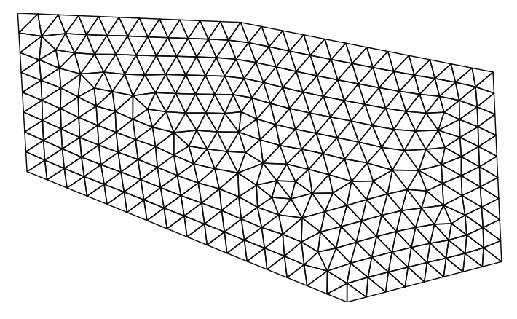
Types of Unstructured Grids
Rectangular based
Quadpatch
Quadtree / Octree
Triangular
Voronoi
Others

Slide 5
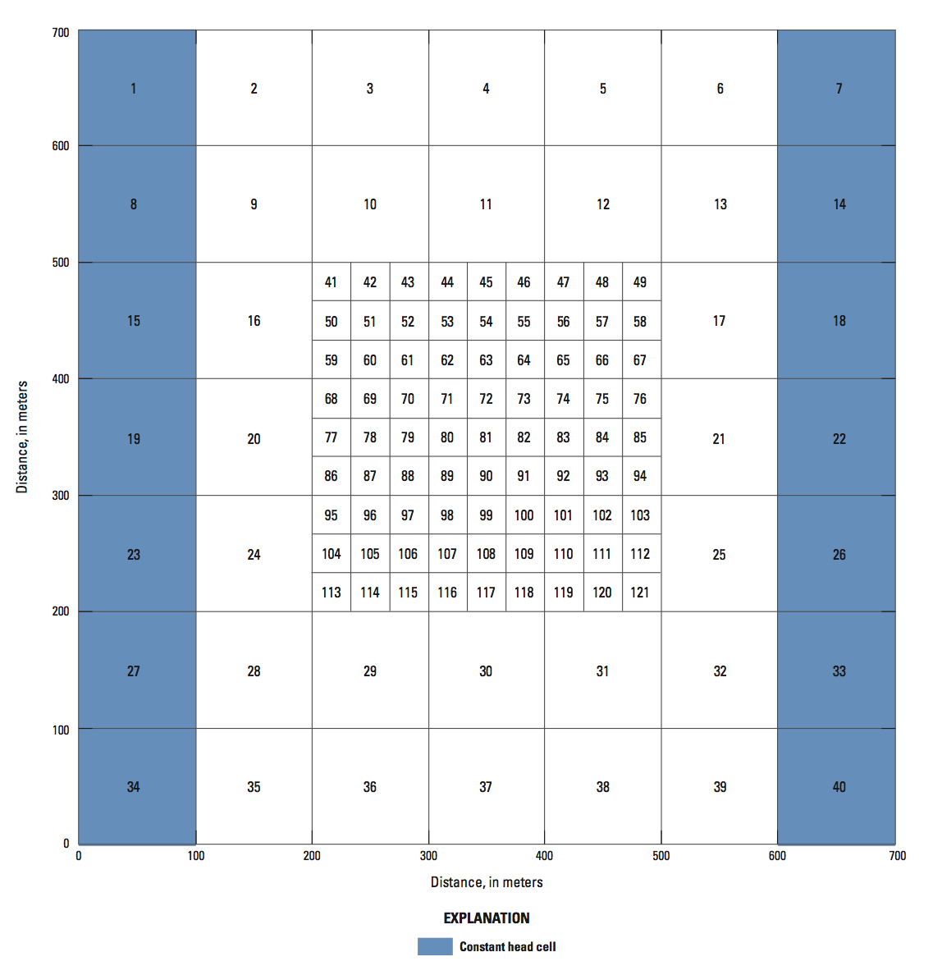
Consequences of Poor Grids

Slide 6
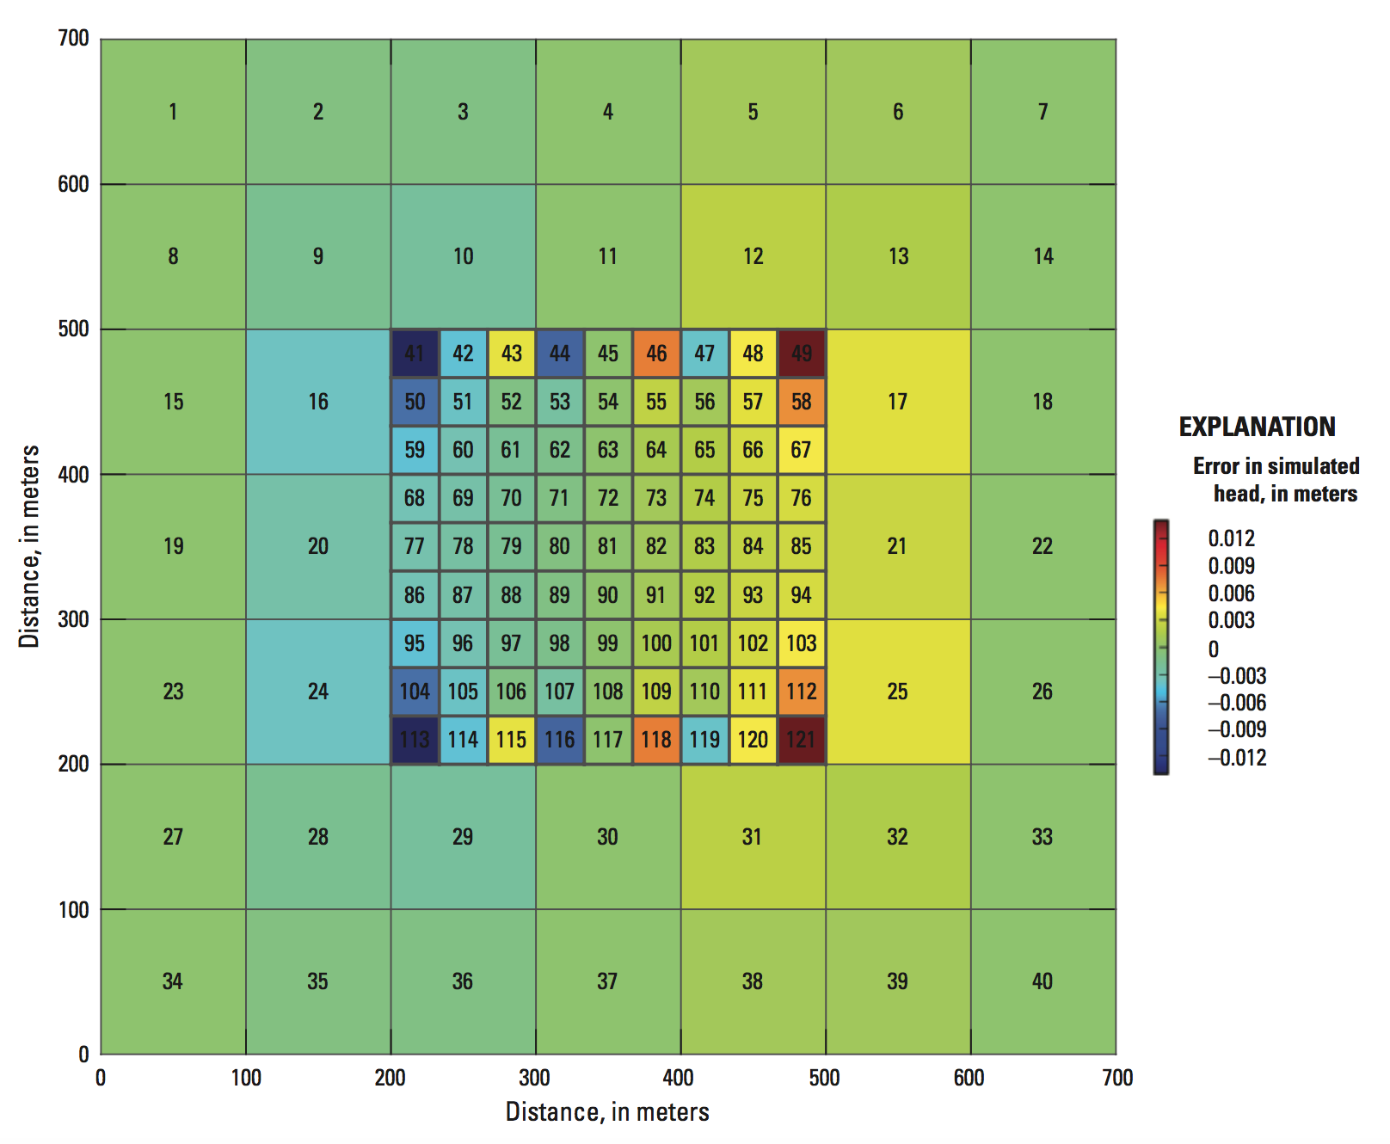
Consequences of Poor Grids

Slide 7
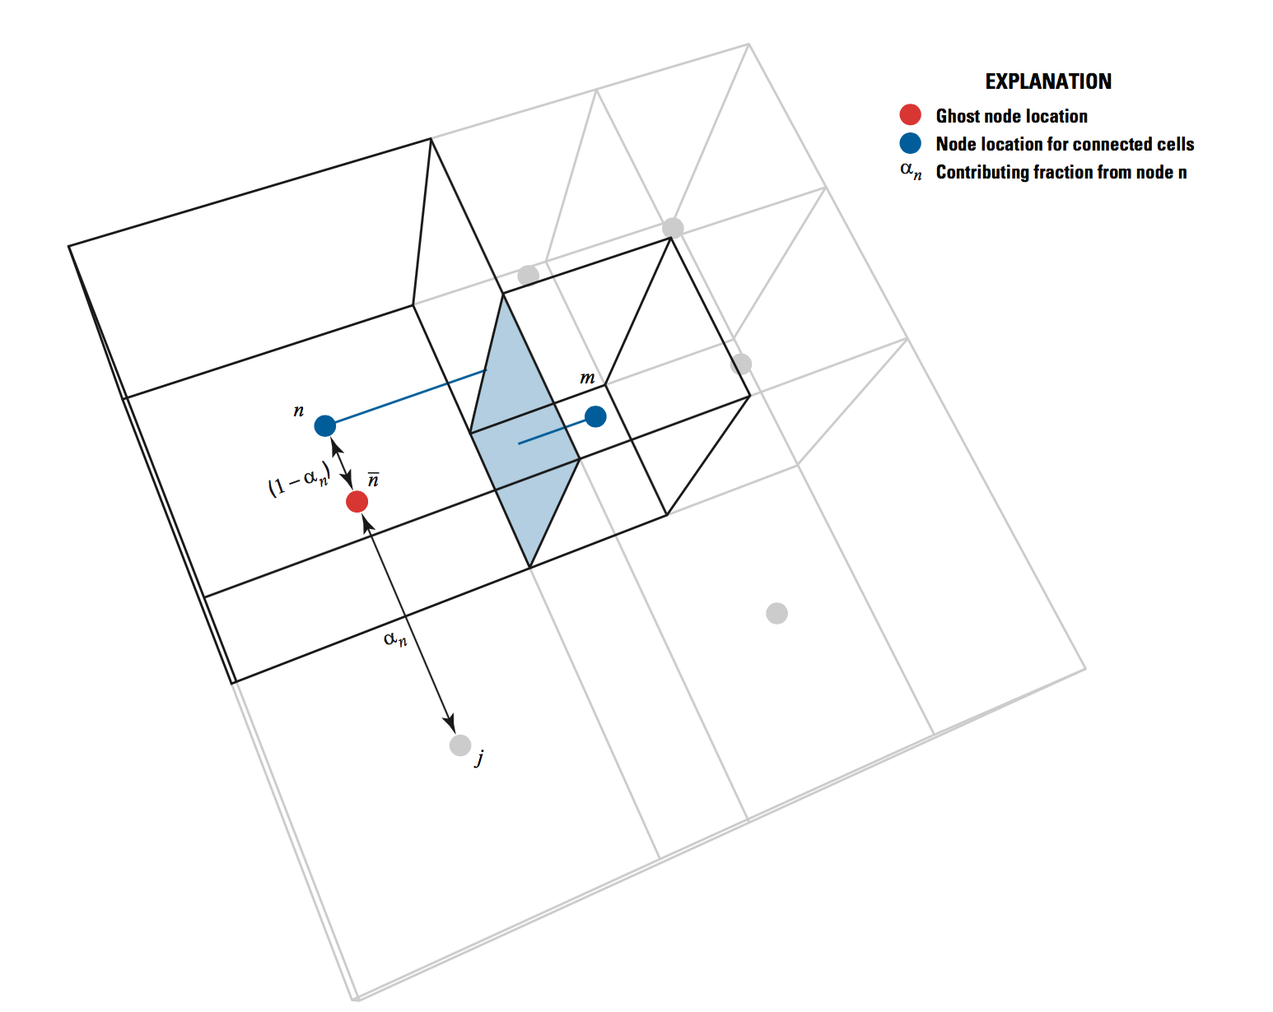
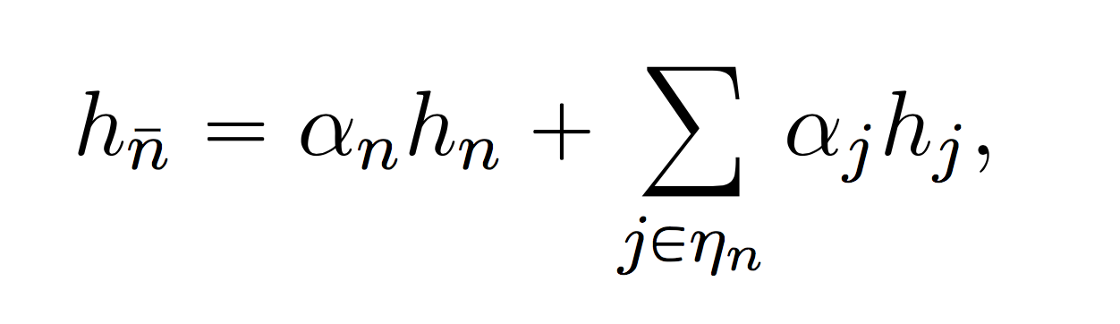
Ghost-Node Correction
Can be used to correct the flow calculation when the CVFD requirement is violated

Slide 8
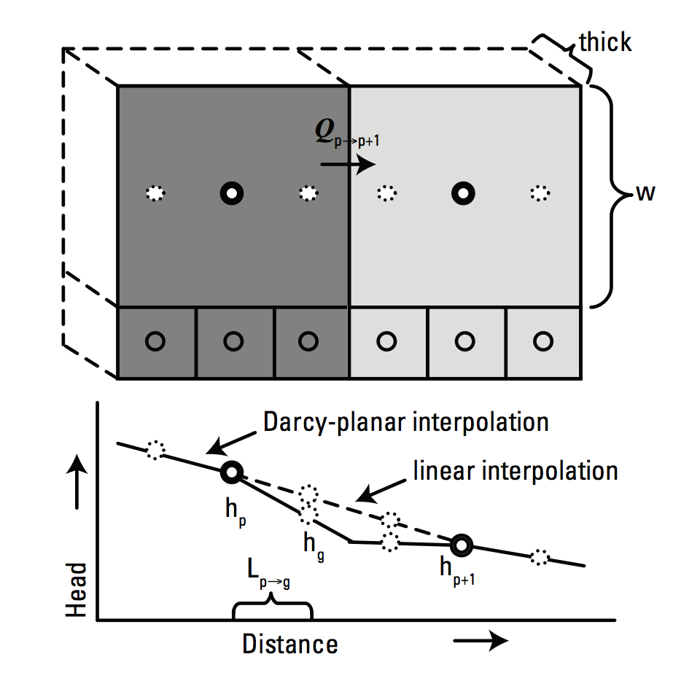
Head Interpolation

Slide 9
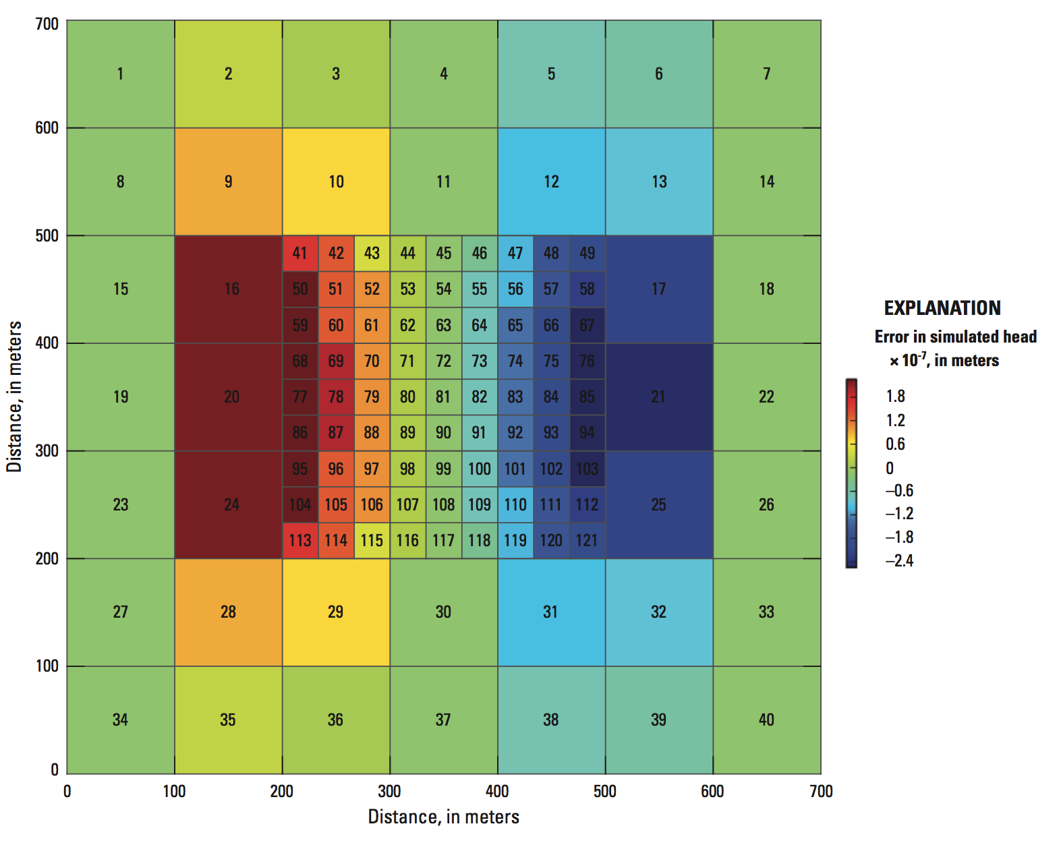
With Ghost Node Correction
Errors are minimized for simple 1D confined groundwater flow

Slide 10
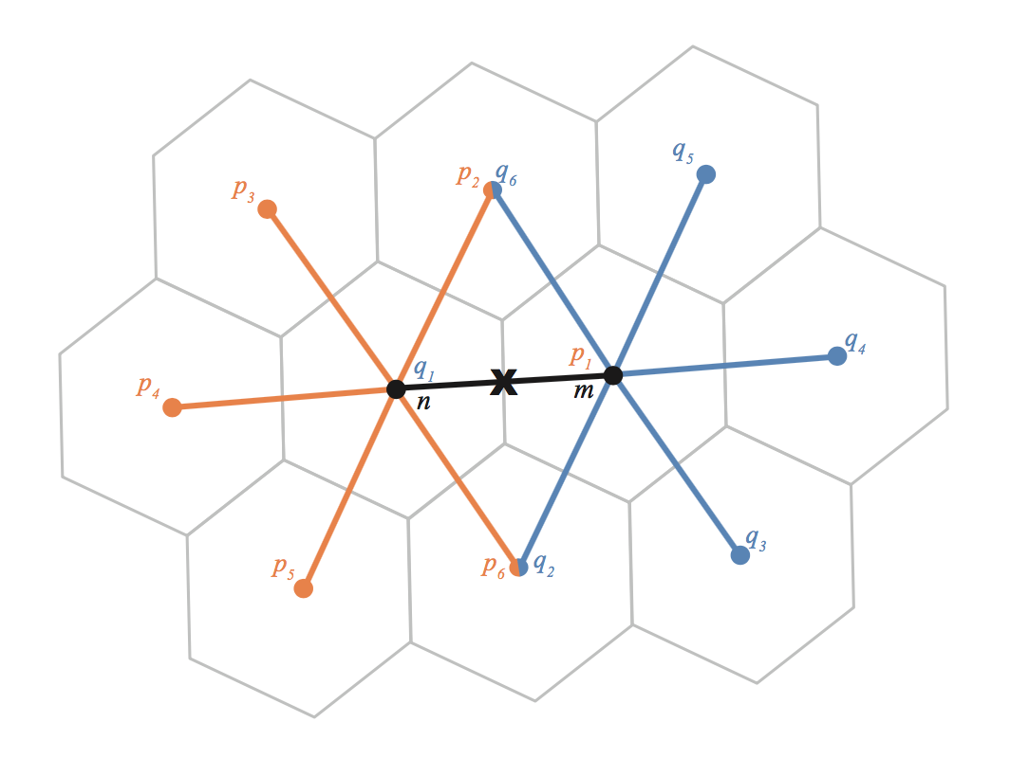
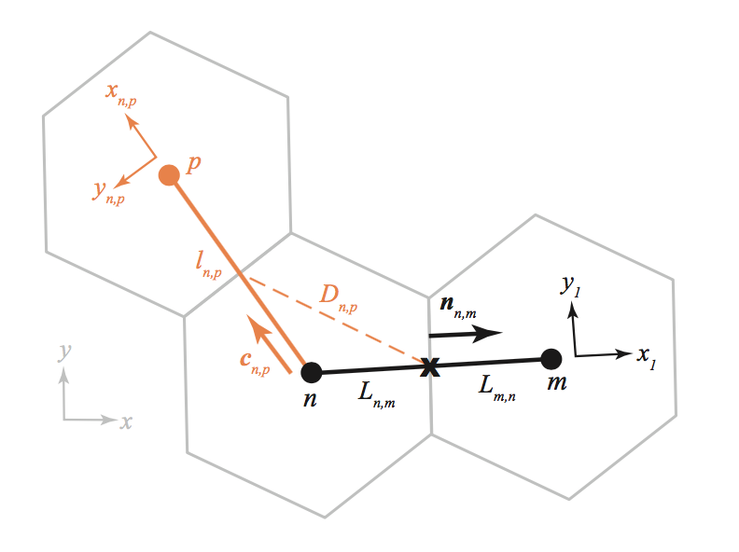
XT3D
Sophisticated flow formulation designed to handle full 3D anisotropy
XT3D also improves flow solution for grids that do not honor the CVFD requirements

Slide 11
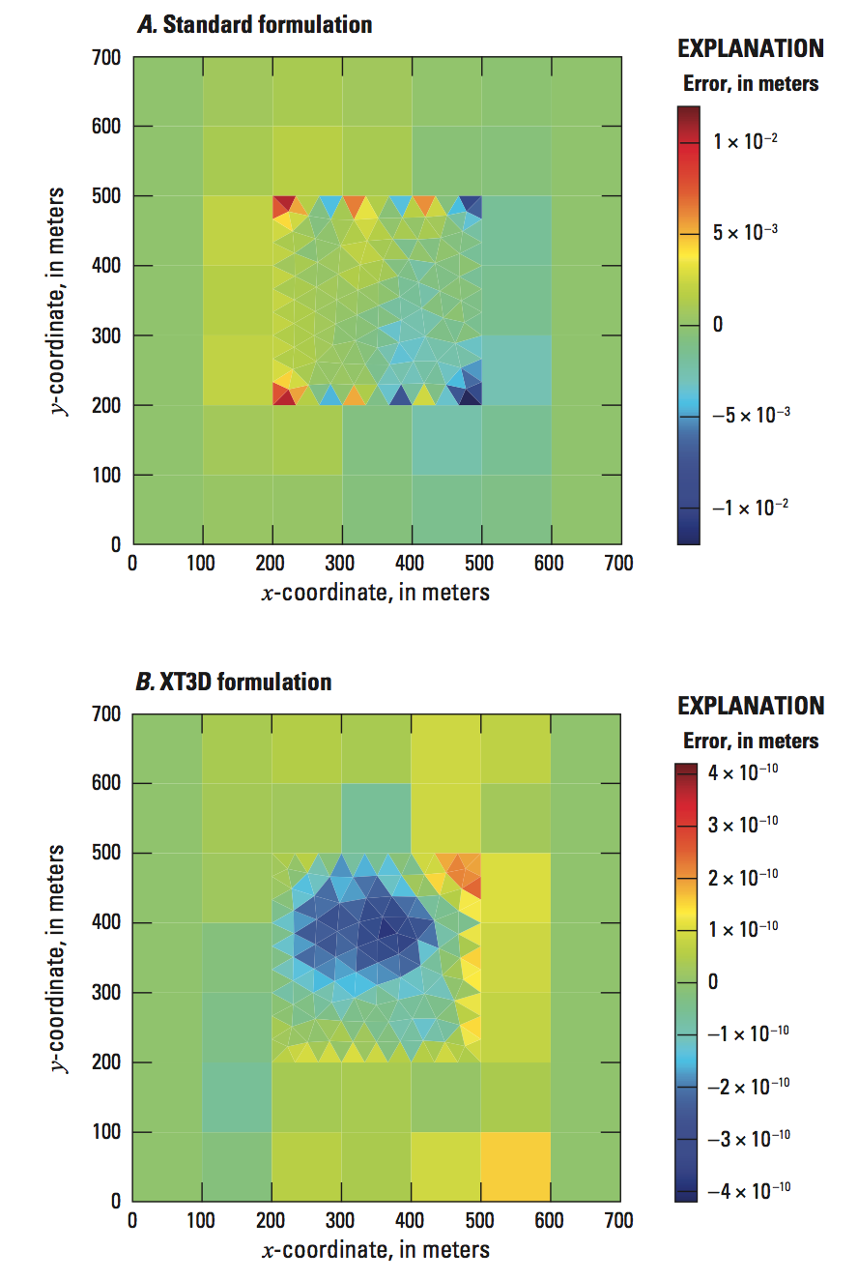
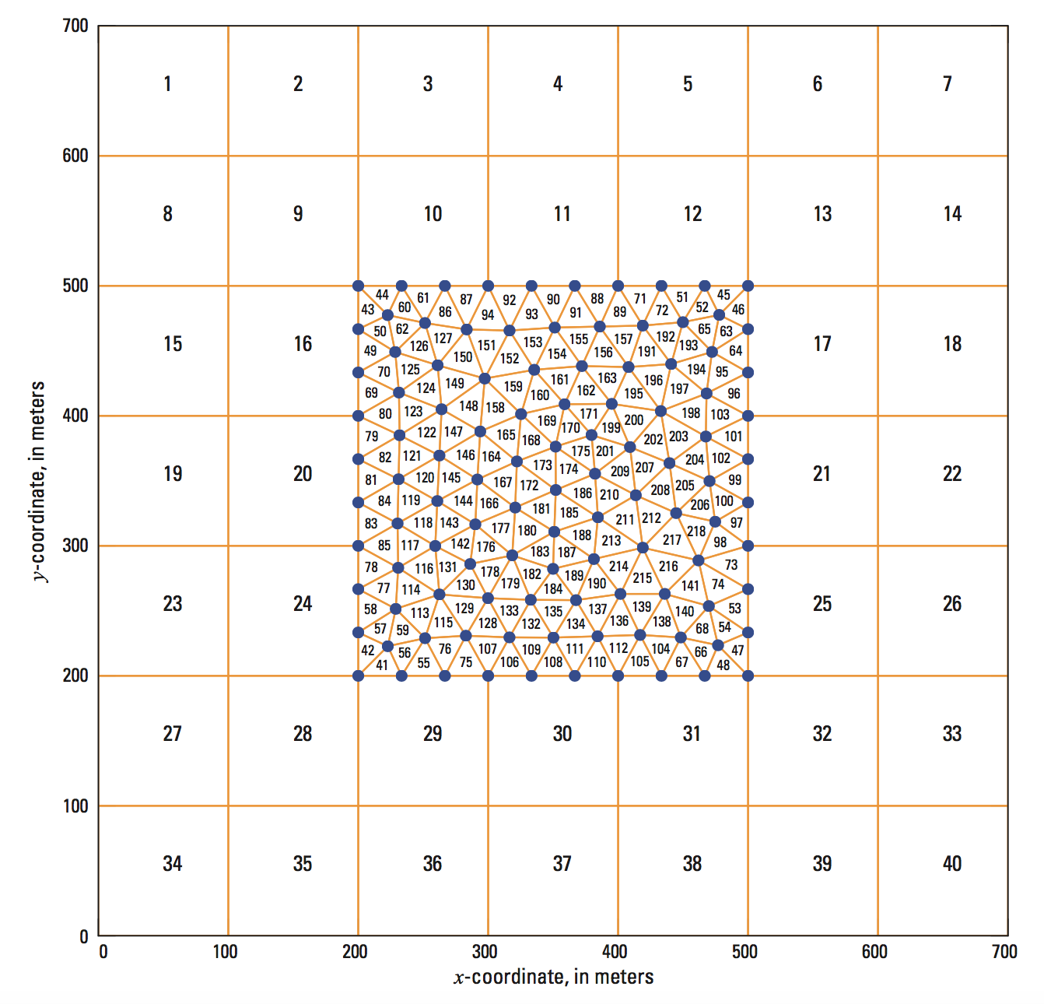
XT3D Solution

Slide 12
Unstructured Grids in MODFLOW 6
Discretization by Vertices (DISV) Package
New in MODFLOW 6
Unstructured Discretization (DISU) Package
Patterned after approach in MODFLOW-USG
Multiple models

Slide 13
“CELLID”
Regular MODFLOW grid (DIS)
(LAYER, ROW, COLUMN)
Discretization by Vertices (DISV)
(LAYER, CELL#)
Unstructured Discretization (DISU)
(CELL NUMBER)

Slide 14
DISV package

Slide 15
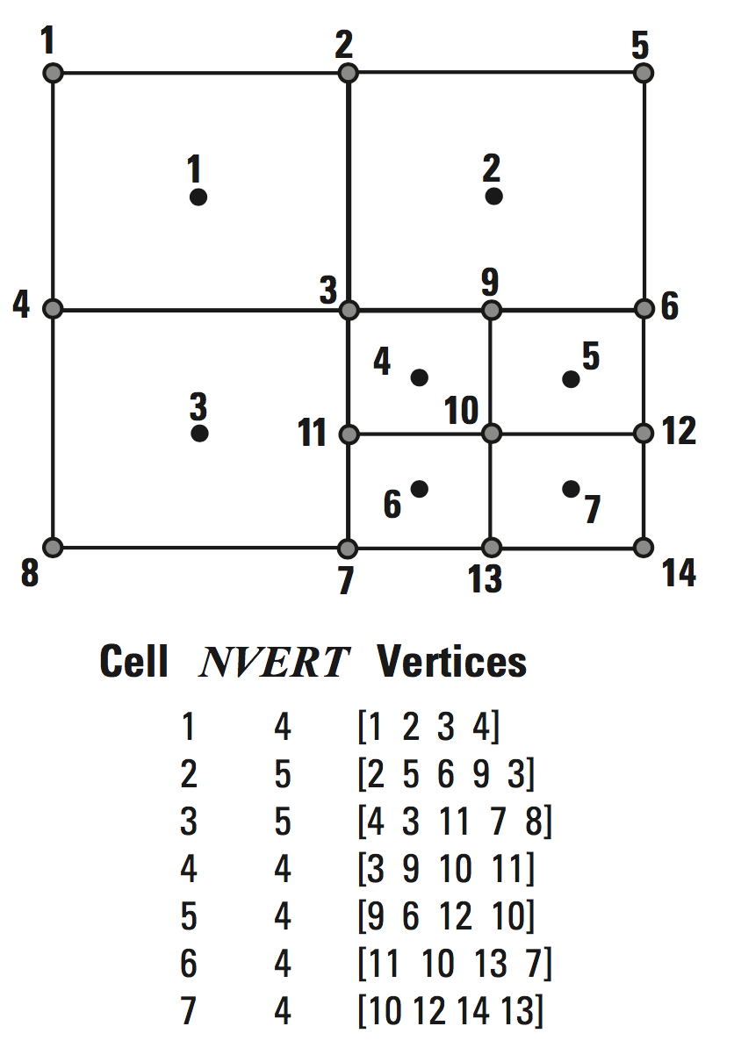
Vertices and Cells

Slide 16
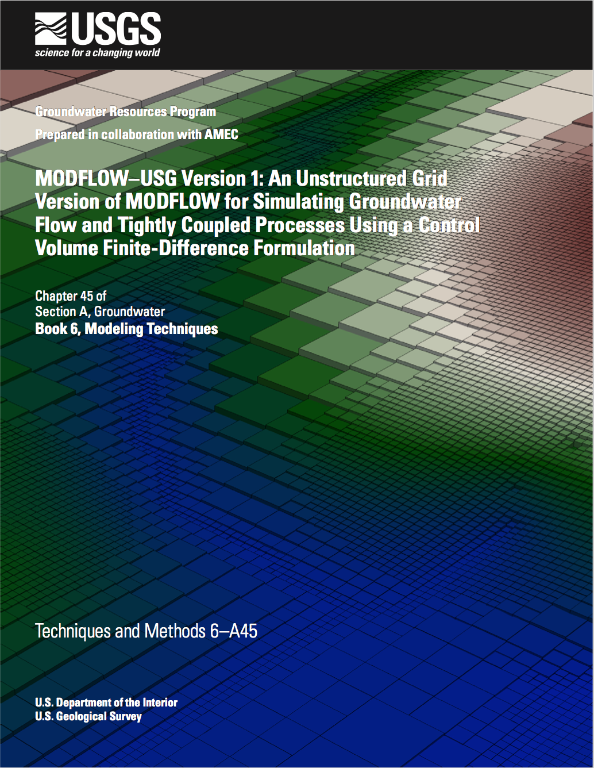
DISU Package

Slide 17
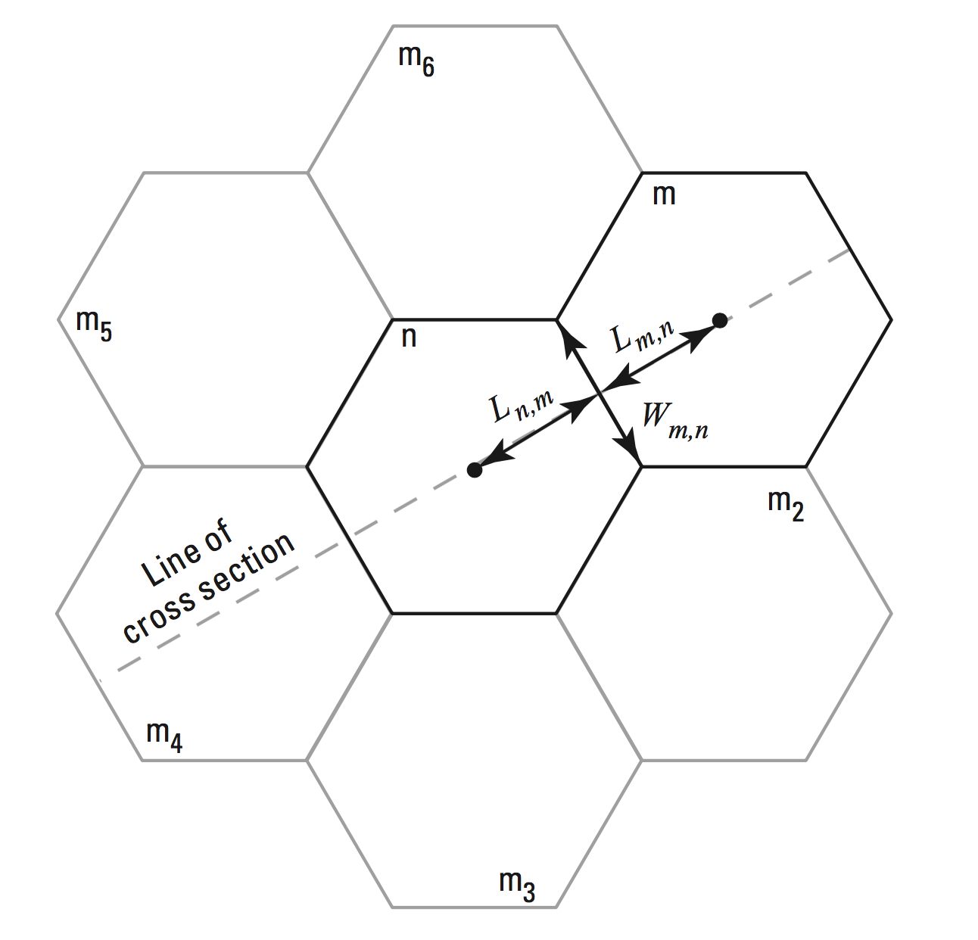
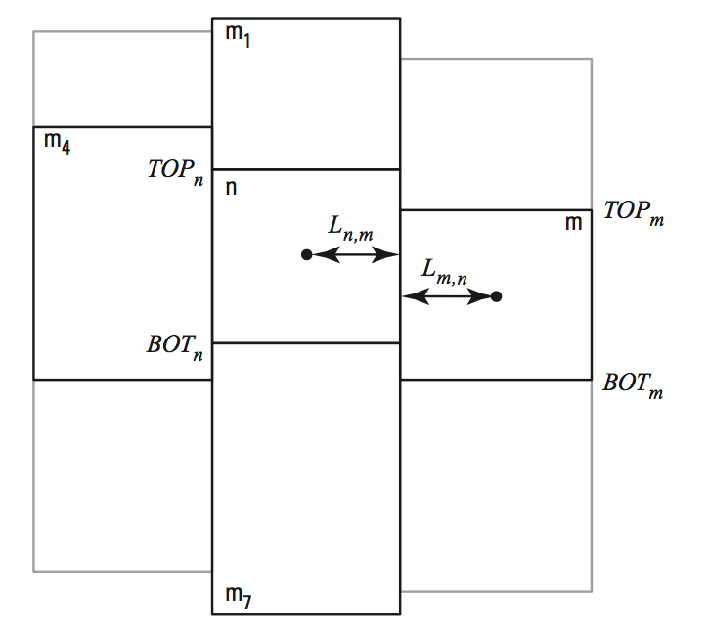
DISU Connections

Slide 18
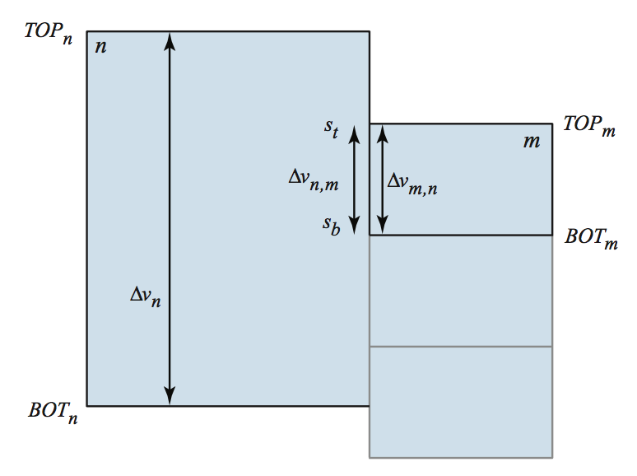
DISU Vertically Staggered Connections
Cell can be connected to more than one cell in a single horizontal direction

Slide 19
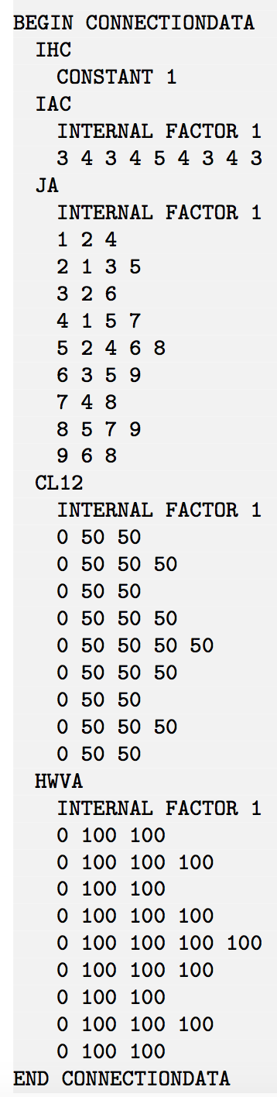
Connection Properties
1
2
3
4
5
6
7
8
9

